Slide 1

ICCAT Workshop: investigation into bycatch estimation methodologies
Module 5: Data cleaning and format for use in the BycatchEstimator tool
Facilitators:
Dr. Beth Babcock
Dr. Ana Adao

Slide 2
Basic data setup
*For non-aggregated data where each row is a trip (or set)
Observer data
Logbook data
Stratification variables
To be expanded against logbook effort
Must be in same units
CPUE standardization
Optional
Matching column
Year | Area | Catch | Effort | Enviro Variable 1 | Trip ID
2010​ | 1 | 3 | 1​00 | 29.72511​ | 1
2010 | 2 | 2 | 120 | 19.97782​ | 2
2011 | 1 | 0 | 142 | 5.932128​ | 3
2011​ | 2 | 1 | 178 | 23.30121​ | 4
2012 | 1 | 5 | 201​ | 22.34505​ | 5
Trip ID | Unsampled effort | Effort | Area | Year
1 | 0 | 1​00 | 1 | 2010​
2 | 0 | 120 | 2 | 2010
3 | 0 | 142 | 1 | 2011
4 | 0 | 178 | 2 | 2011​
5 | 0 | 201​ | 1 | 2012

Slide 3
Observer data sample units
The observer data must be aggregated to the appropriate sample unit, either trips or sets, with one row per sample unit.
E.g. can’t have multiple rows per set. Convert from “long” to “wide” format if needed
Long format
Wide format
TripID | Set | Year | Month | Day | Gear | Hooks | Species | Number
GA92910 | 1 | 2020 | 11 | 20 | LL | 602 | BUM | 2
GA92910 | 1 | 2020 | 11 | 20 | LL | 602 | SWO | 11
GA92910 | 1 | 2020 | 11 | 20 | LL | 602 | SMA | 1
GA92910 | 2 | 2020 | 11 | 21 | LL | 889 | SWO | 6
GA92910 | 2 | 2020 | 11 | 21 | LL | 889 | BUM | 1
GA92910 | 3 | 2020 | 11 | 22 | LL | 322 | SWO | 5
GA39299 | 1 | 2020 | 5 | 2 | LL | 592 | SWO | 9
GA39299 | 1 | 2020 | 5 | 2 | LL | 592 | BUM | 1
GA65753 | 1 | 2020 | 3 | 4 | LL | 592 | SWO | 5
GA65753 | 2 | 2020 | 3 | 4 | LL | 508 | SWO | 1
GA65753 | 3 | 2020 | 3 | 4 | LL | 497 | SWO | 10
TripID | Set | Year | Month | Day | Gear | Hooks | BUM | SWO | SMA
GA92910 | 1 | 2020 | 11 | 20 | LL | 602 | 2 | 11 | 1
GA92910 | 2 | 2020 | 11 | 21 | LL | 889 | 1 | 6 | 0
GA92910 | 3 | 2020 | 11 | 22 | LL | 322 | 0 | 5 | 0
GA39299 | 1 | 2020 | 5 | 2 | LL | 592 | 1 | 9 | 0
GA65753 | 1 | 2020 | 3 | 4 | LL | 592 | 0 | 5 | 0
GA65753 | 2 | 2020 | 3 | 4 | LL | 508 | 0 | 1 | 0
GA65753 | 3 | 2020 | 3 | 4 | LL | 497 | 0 | 10 | 0

Slide 4
Logbook data sample units
Total effort data doesn’t have to be from logbooks, data from landings records, etc. could also work.
Effort must be in the same units in both observer data and logbook data
E.g. make sure you don’t have “hooks” in one and “hook-hours” in the other.
The “logbook” data may be aggregated to sample units, or it may be aggregated further, as long as it includes data on all stratification or predictor variables, and number of sample units if aggregated
Effort data aggregated by area, year and month.
Area | Year | Month | Sets | Hours
NW | 2010 | 11 | 54 | 578
NE | 2010 | 12 | 15 | 201

Slide 5
Variable columns
The observer data should have columns for year and the other predictor variables, the observed effort and the observed bycatch (or catch) of each species to be estimated
The logbook data must also have the same predictor variables, and the total effort, all in the same units as the observed data
If there are any NA values, those rows will be deleted from the data set

Slide 6
Including observed catch as a known constant
To include the observed catches as known in the totals, include a column for unsampled effort in the logbook data (which can be zero in completely sampled trips/sets) and a column in both the logbook and observer data that can be used to match observer trips/sets to logbook records
Observed bycatch + Predicted bycatch = Total bycatch
Bycatch will be predicted only from unobserved effort (i.e. trips or sets not sampled by observers)
This only works if
the amount of observed effort in a trip/set is always less than or equal to the amount of total effort
You can exactly match trips/sets

Slide 7
Including observed catch as a known constant
For fisheries with high observer coverage (e.g. 20% or more), predicting bycatch from only unobserved effort would be preferred, because treating the whole fishery as unobserved might overestimate the variance

Slide 8
Quality control and data cleaning
Before running bycatchEstimator, make plots to see if the data all look correct.
There is also a function (in beta testing) in the bycatchEstimator called
dataCheck() that takes the output of BycatchSetup as an input.
So, you can run bycatchSetup() then dataCheck() before running models.

Slide 9
Quality of the data – things to look out for in model based estimation
Factor variables must have all levels included in both observer and logbook data
Range of numerical variables must be similar in observer and logbook data
Gaps in time series of bycatch or variables
If the species was not observed in some levels of factor variables, the model may not be able to estimate coefficients for the variable
For delta-lognormal and delta-gamma, must have at least some positive observations in each year
Outliers
If bycatch occurs in a set/trip with very low observed effort, this can inflate the bycatch estimate (eg a typo in effort column)
Step changes/Trends in diagnostic plots indicating possible changes in the fishery

Slide 10
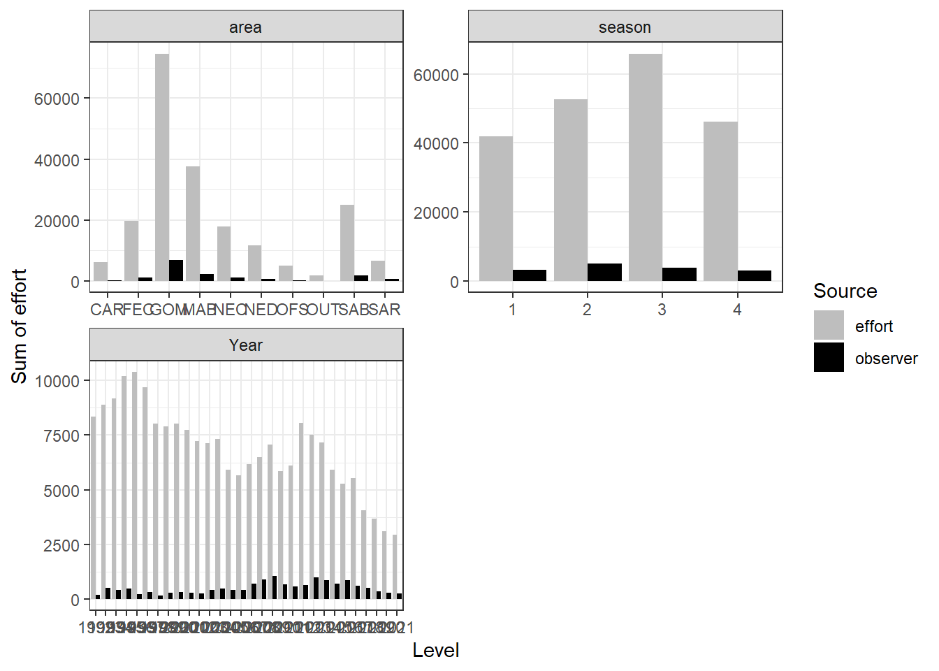
Categorical variables
e.g. US pelagic longline
All levels of factors must exist in both observer and effort data, or the model cannot estimate the coefficients
Possible solution if some factors are missing:
combine levels of a factor (e.g. area=other)
Use a more aggregated variable (e.g. season instead of month)
Exclude under-sampled parts of the fishery from analysis (e.g. calculate bycatch for commonly fished areas only)

Slide 11
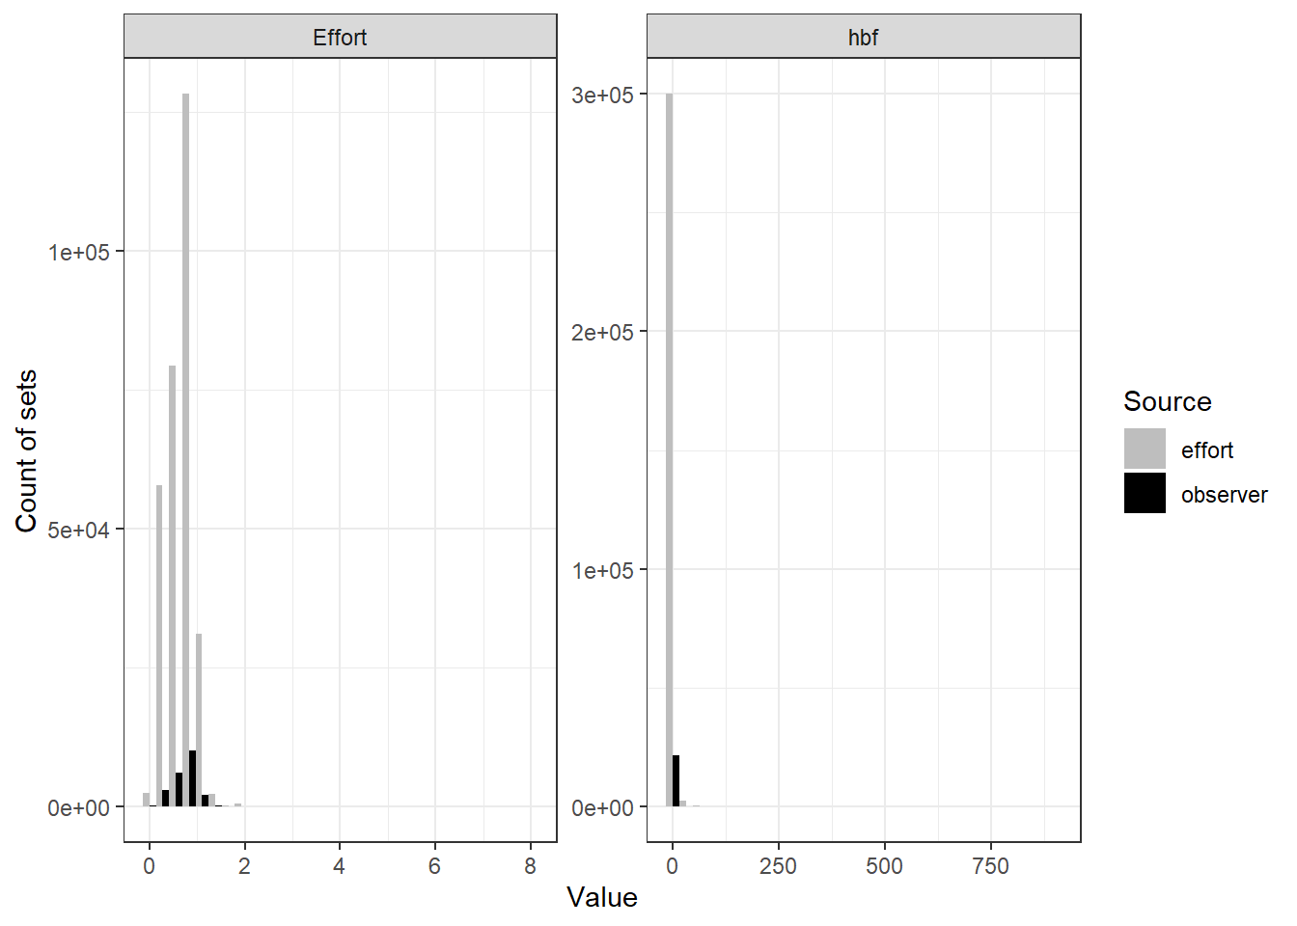
Numerical variables
Numerical variables produce a regression, so the model will extrapolate beyond the data. This can cause very biased estimates.
Check for very large or small values of the variable in the logbook data
Replace logbook data outliers with a more reasonable value (e.g. the mean)
Also, check no units have very small effort in the observer data. Effort near zero will lead to large bycatch estimate
Observer max =35
Logbook max=900

Slide 12
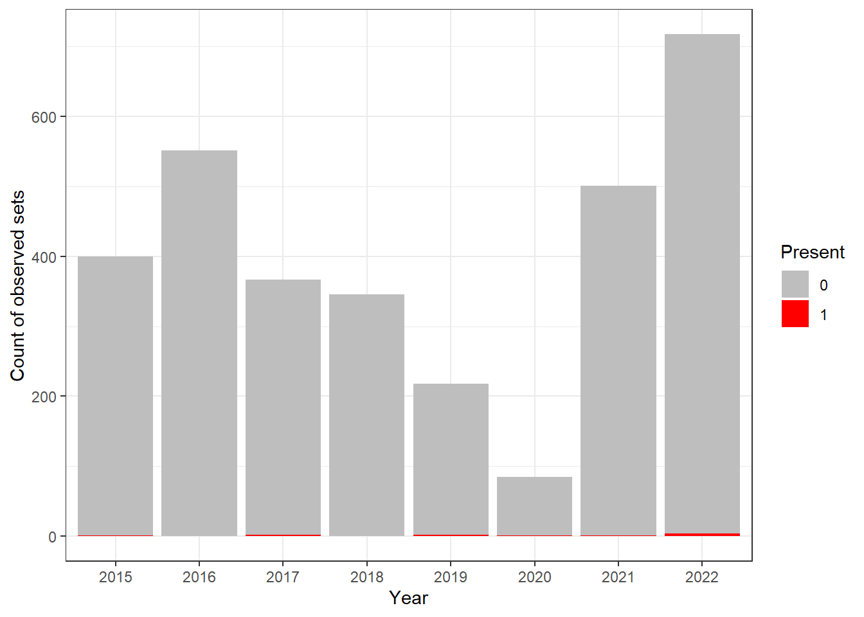
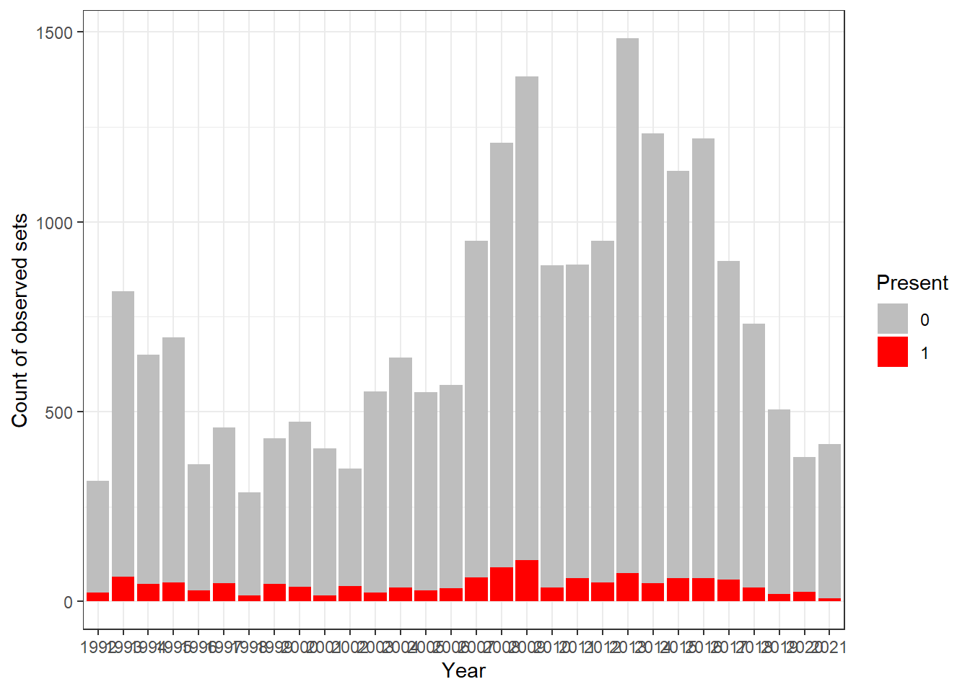
Years with no positive observations
Smalltooth sawfish in US Gulf of Mexico shrimp trawl
BUM in US PLL
BycatchEstimator will not run delta-lognormal and delta-gamma if any years have no positive catch

Slide 13
Data Summary Table

Slide 14
Working with data in BycatchEstimator
Inputs
Key functions
Outputs
Observer data
bycatchSetup
Sets global conditions and makes a preliminary data summary.
Data summary
PDF
CSV
Setup file (.rds)
Design-based estimators
Logbook data
Main analysis
Within-model variable selection
Residuals and diagnostics
Annual abundance indices
Annual total bycatch
Cross-validation of CPUE prediction
PDF / CSV
bycatchFit
Produces model-based estimates of bycatch and annual abundance index

